Slide 1
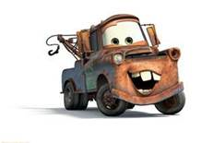

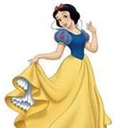
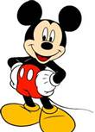
How are these characters similar? With a partner, list 3 ways they are alike.

Slide 2
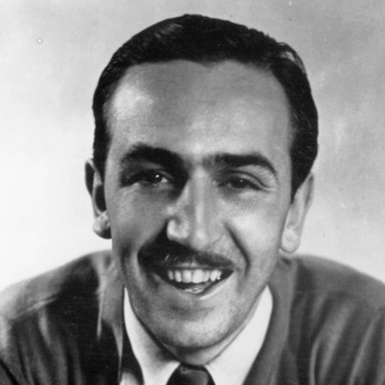
Created by Walt Disney
Walt Disney was the creator of the first animated film (cartoon), Steamboat Willie.
He invented the technology used to make movies from pictures drawn by hand.
He is notable because he started the Disney company.

Slide 3


Creative, Inventive, and notable people
L.3.4, L.3.5
SL.3.1c
GH 3S
In Unit 3, we will be reading and writing about people who are creative, inventive and notable. Today we will talk about what these words mean and how the words are similar and different.

Slide 4
Score Yourself
I can identify people who are creative, inventive, and notable
I can explain how these three words are similar and different
    4: I could teach this to a Kindergartener
    3: I can do this correctly on my own
    2: I might need help
    1: I think this is new

Slide 5
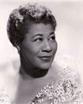
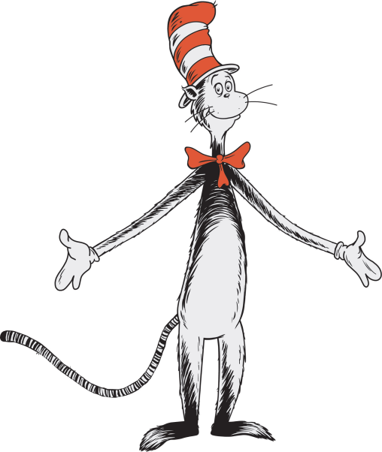
Creative
The word comes from “create” What does create mean?
  Create – to make something; to produce visual or performance art
Creative is an adjective that describes a person who creates
The person is called a creator
Ella Fitzgerald, Singer
Dr. Seuss:
The Cat in the Hat

Slide 6
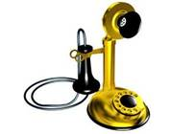

Inventive
The word comes from “invent” What does invent mean?
  Invent – think of or build something first
Inventive is an adjective that describes a person who invents
The person is called an inventor
Alexander Graham Bell:
The Telephone
Thomas Edison:
The Lightbulb

Slide 7
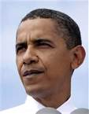
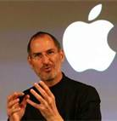
Notable
The word comes from “note” What does note mean?
  Note – pay attention to a person or idea that is important or interesting
Notable is the adjective that describes a person or idea
Barack Obama:
The first Black (African-American) President of the US
What makes these two people important?
Steve Jobs:
Founder of The Apple Company

Slide 8
How are these words the same and different?
Talk to your partner.
Creative
A person who makes something or produces visual or performance art
Inventive
A person who thinks of or builds something first
Notable
A person or idea that is important or interesting

Slide 9
Think about these people. Are they creative, inventive, or notable? On your paper, put their names in the area you think they belong.
Creative
Notable
Inventive
Sally Ride, first female astronaut
George Washington, first US president
Taylor Swift, musician
Henry Ford, founded the company that made the first affordable cars
Wright brothers, first to fly
Doreen Cronin, author of Click, Clack, Moo
Picasso, painter and sculptor

Slide 10
Score Yourself
I can identify people who are creative, inventive, and notable
I can explain how these three words are similar and different
    4: I could teach this to a Kindergartener
    3: I can do this correctly on my own
    2: I might need help
    1: I think this is new

